Slide 1
A 3D Heat Transfer Model of a Glass Additive Manufacturing Process
Zechariah Jibben, Naren Raghavan, John Bernardin
LA-UR-23-26084

Slide 2
Introduction
Additive manufacturing of glass is an emerging technology
Laser-heated, filament-fed glass additive manufacturing system (GLAMS).
Thermal profile within the glass and near melt region strongly influences final quality.
Simulate the thermodynamics of the printing process.
Inform experiment and design with the following.
Temperature and temperature gradient data
Trends (if we change this input, how does the process change? E.g. cooling rates, thermal gradients)
New approaches (multiple lasers, beam shaping, etc.)
Pair with or develop empirical relationships to understand bubble entrapment, cracking, etc.

Slide 3
Truchas
Open source LANL-developed software for physics-based modeling. https://www.truchas.org
Core capabilities designed for metal casting but has been applied to ocean modeling and powder-bed fusion additive manufacturing.
Provides coupled physics models for the following.
Incompressible multi-material flow with interface tracking
Heat transfer
Phase change with latent heat
View factor thermal radiation
Species advection-diffusion
Elastic/plastic small-displacement mechanics with contact
Electromagnetics
Employs finite volume, finite element, and mimetic finite difference discretizations on 3D unstructured meshes of mixed-element cell types.

Slide 4
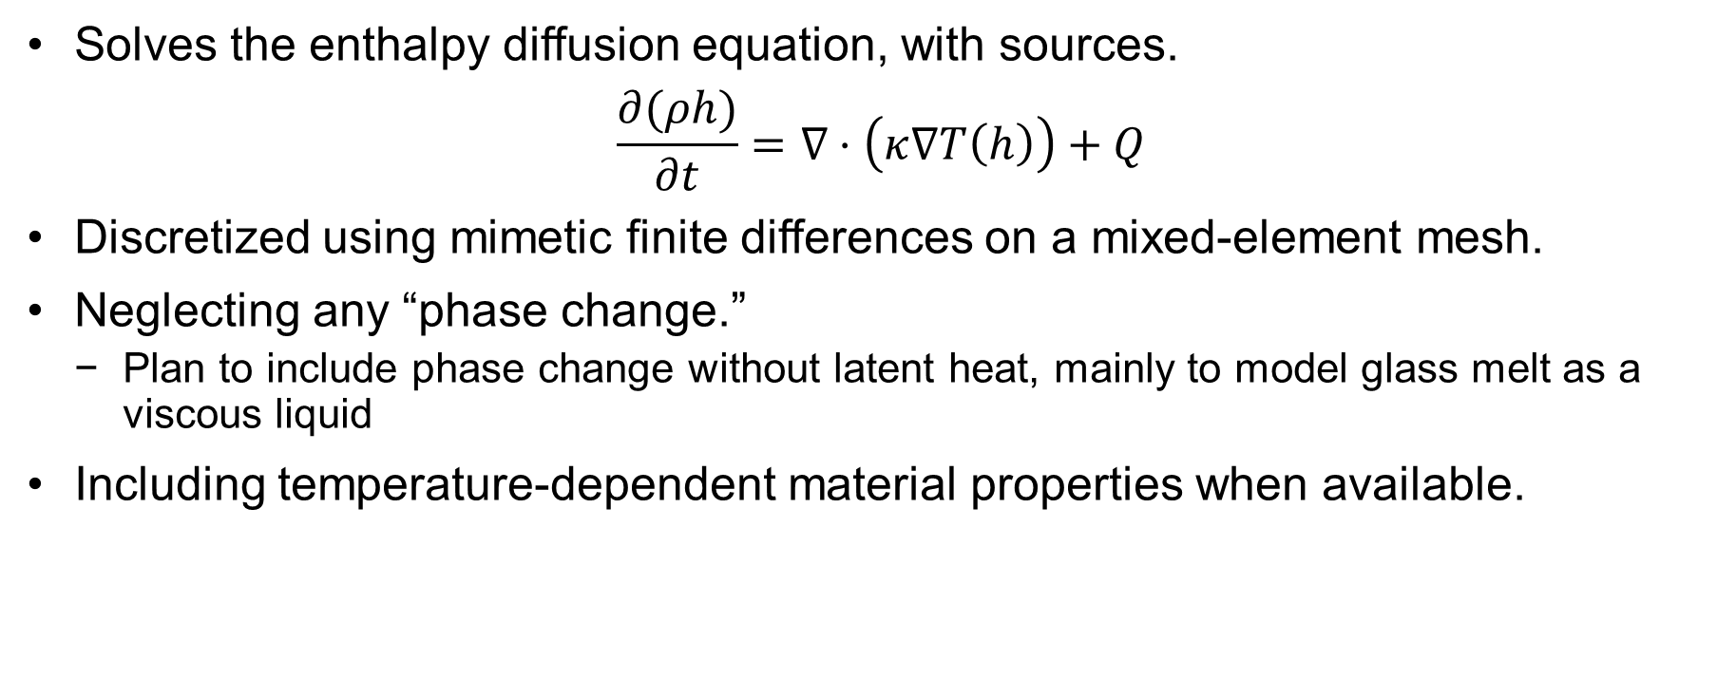
Truchas Heat Transfer Model
Solves the enthalpy diffusion equation, with sources.
$$\frac{∂(ρh)}{∂t}=∇⋅\left(κ∇T\left(h\right)\right)+Q$$
Discretized using mimetic finite differences on a mixed-element mesh.
Neglecting any “phase change.”
Plan to include phase change without latent heat, mainly to model glass melt as a viscous liquid
Including temperature-dependent material properties when available.

Slide 5
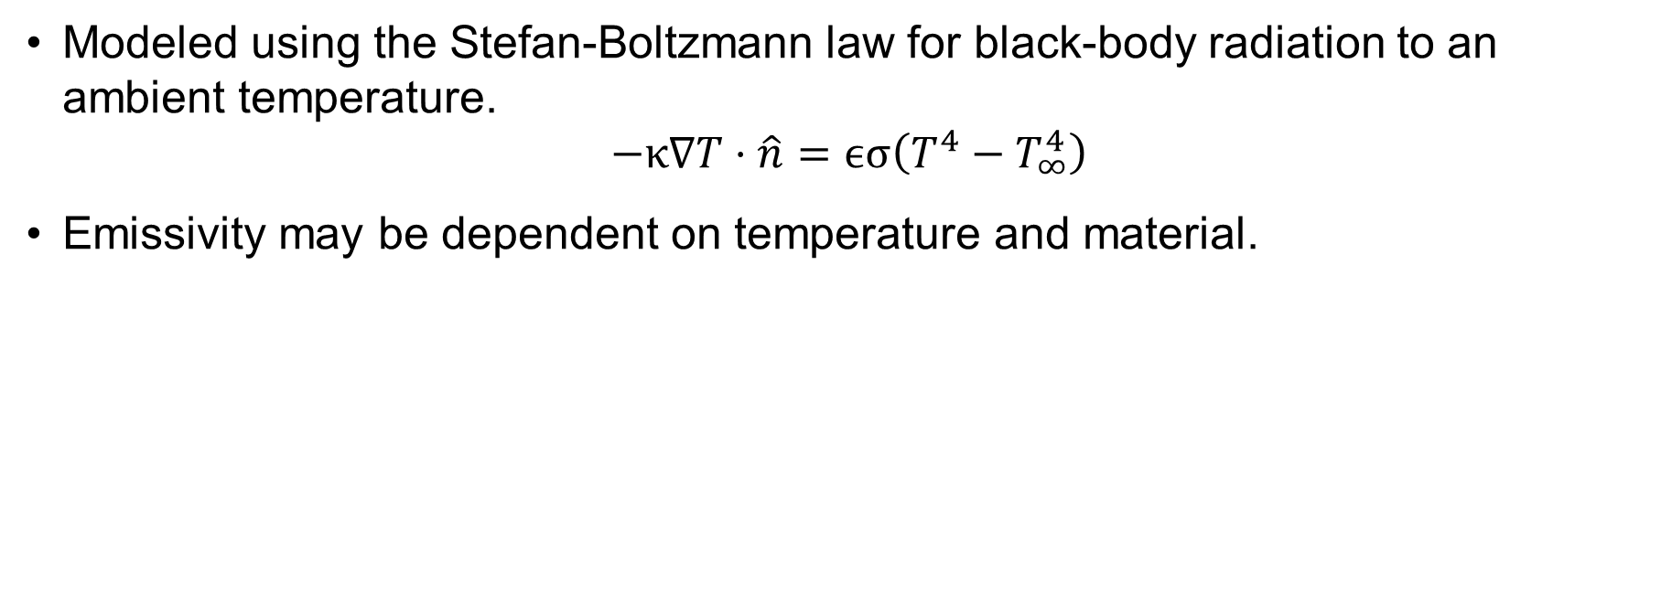
Radiation
Modeled using the Stefan-Boltzmann law for black-body radiation to an ambient temperature.
$$−κ∇T⋅\hat{n}=ϵσ\left(T^{4}−T_{∞}^{4}\right)$$
Emissivity may be dependent on temperature and material.

Slide 6
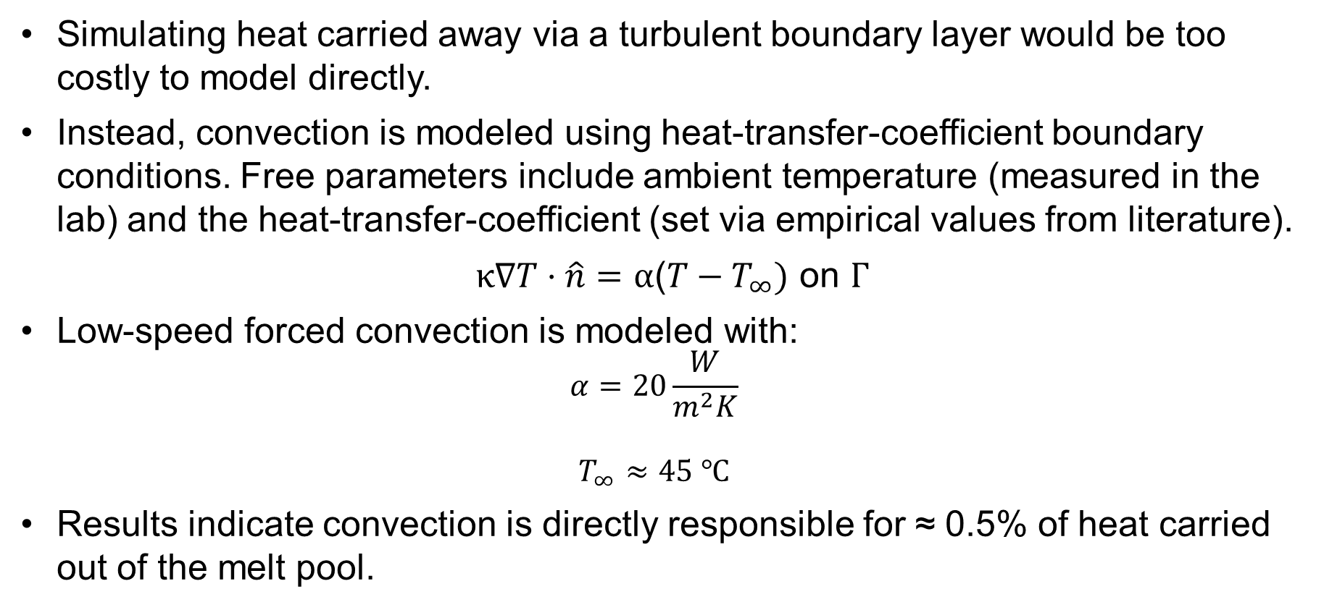
Convection
Simulating heat carried away via a turbulent boundary layer would be too costly to model directly.
Instead, convection is modeled using heat-transfer-coefficient boundary conditions. Free parameters include ambient temperature (measured in the lab) and the heat-transfer-coefficient (set via empirical values from literature).
$κ∇T⋅\hat{n}=α\text{(}T−T_{∞}) \text{on} Γ$
Low-speed forced convection is modeled with:
$$α=20\frac{W}{m^{2}K}$$
$$T_{∞}≈45 ℃$$
Results indicate convection is directly responsible for ≈ 0.5% of heat carried out of the melt pool.

Slide 7
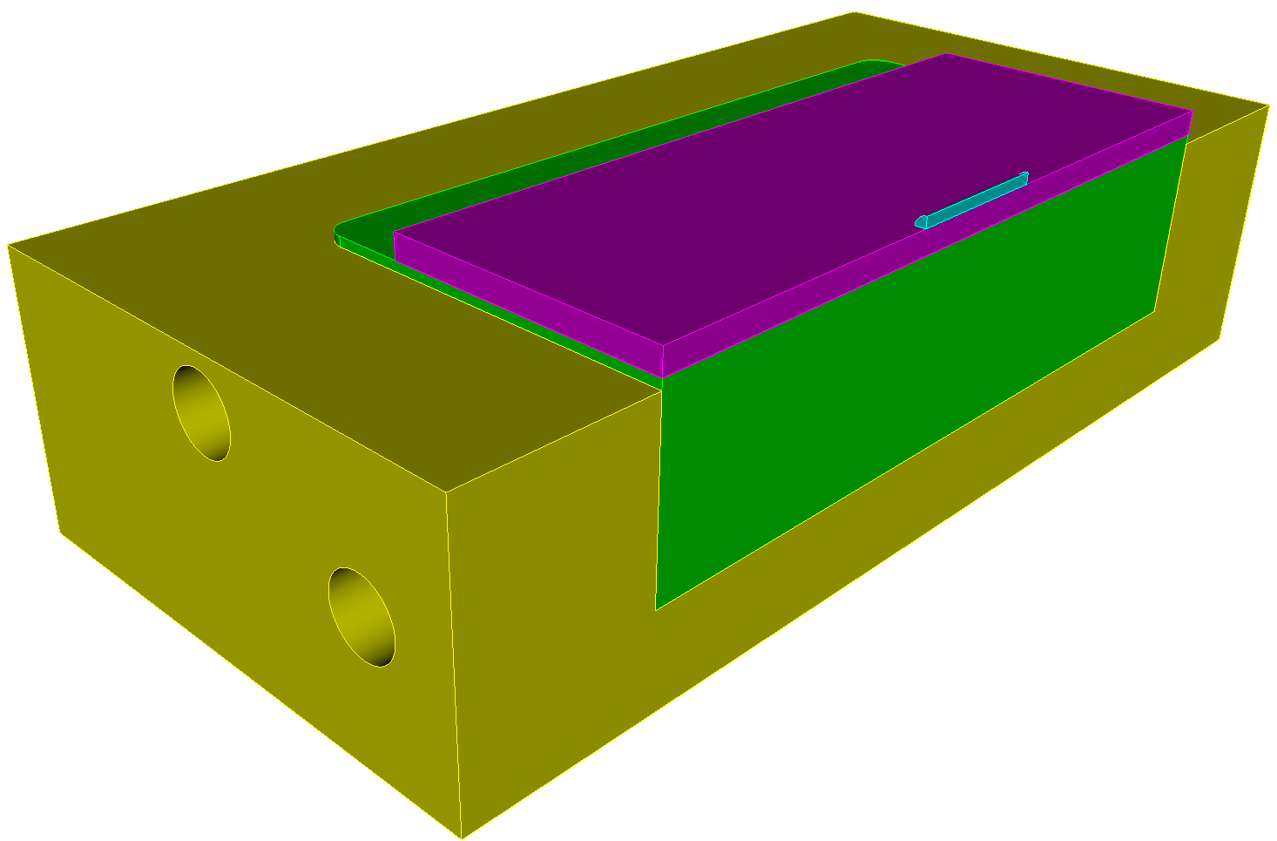
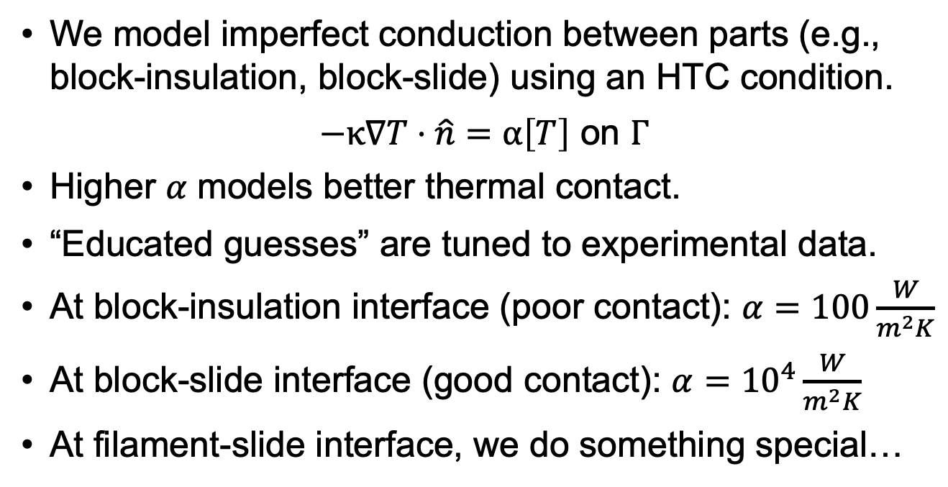
Component Interface
We model imperfect conduction between parts (e.g., block-insulation, block-slide) using an HTC condition.
$−κ∇T⋅\hat{n}=α\left[T\right] \text{on} Γ$
Higher 𝛼 models better thermal contact.
“Educated guesses” are tuned to experimental data.
At block-insulation interface (poor contact): $α=100\frac{W}{m^{2}K}$
At block-slide interface (good contact): $α={10}^{4}\frac{W}{m^{2}K}$
At filament-slide interface, we do something special…

Slide 8
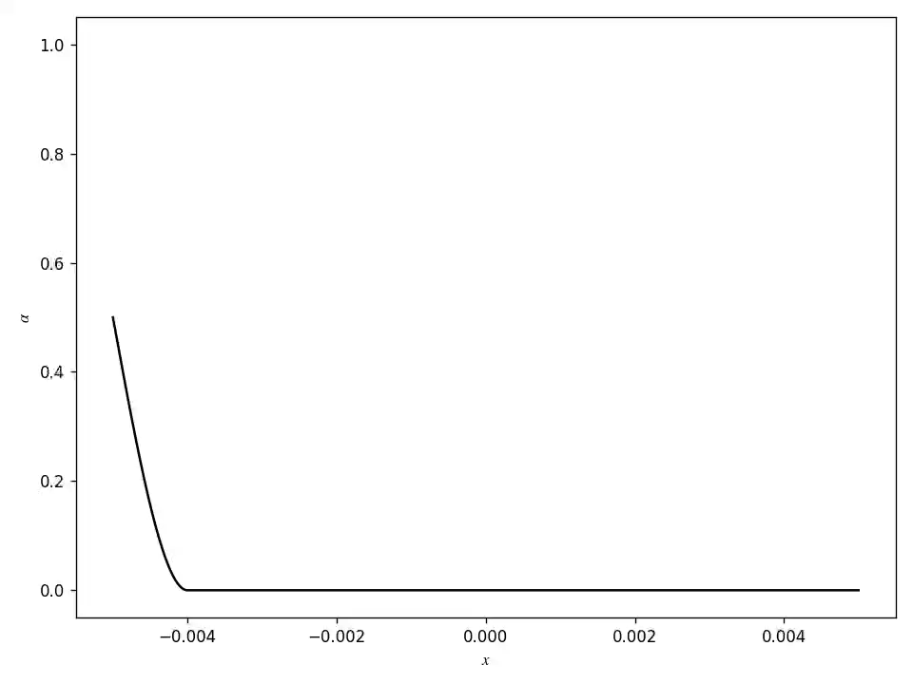
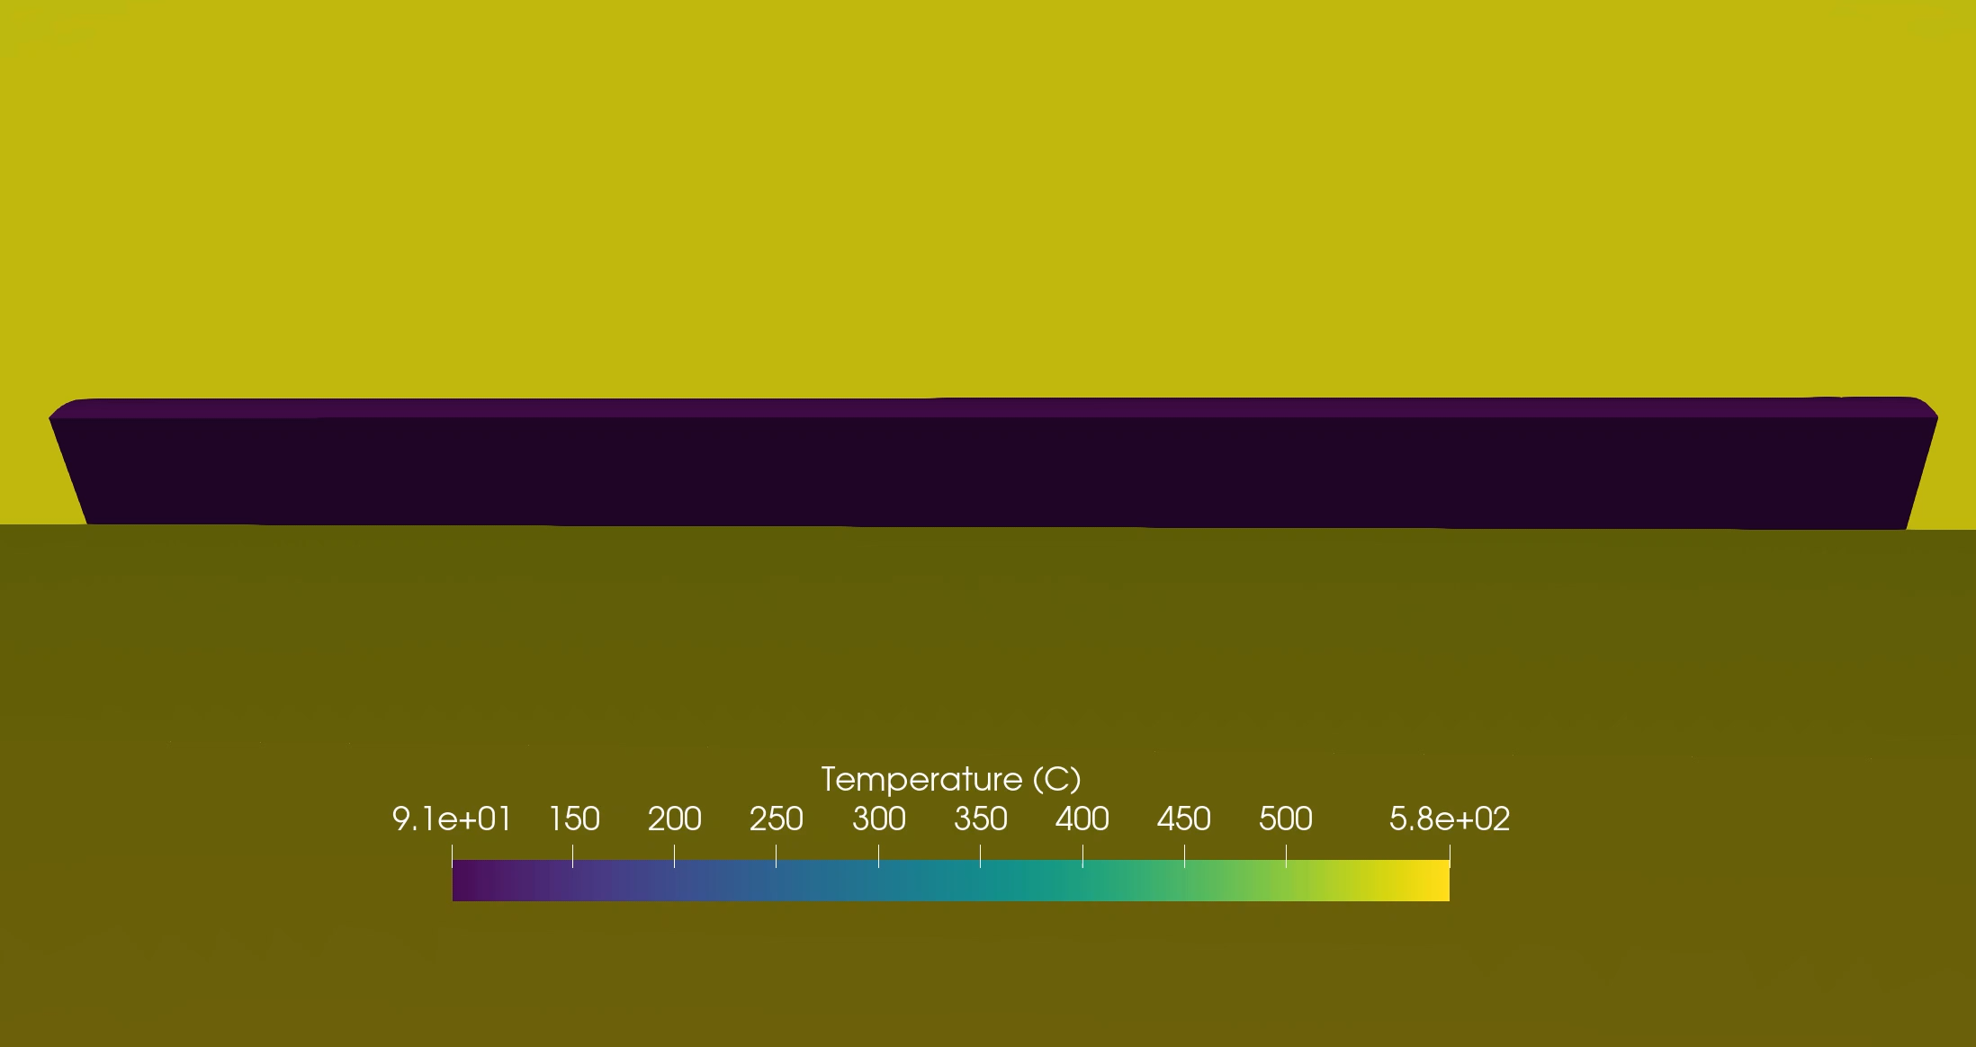
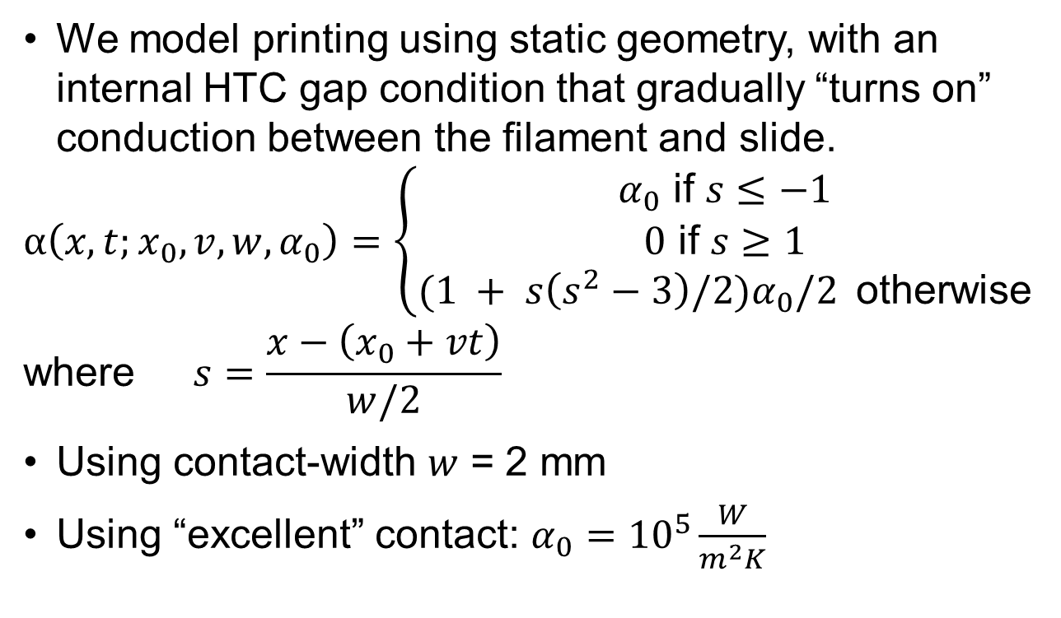
Printing: Sliding HTC Gap Condition
We model printing using static geometry, with an internal HTC gap condition that gradually “turns on” conduction between the filament and slide.
$$α\left(x,t;x_{0},v,w,α_{0}\right)=\left\{\begin{aligned}α_{0} \text{if} s≤−1 \\ 0 \text{if} s≥1 \\ (1 + s\left(s^{2}−3\right)/2)α_{0}/2 \text{otherwise}\end{aligned}\right.$$
$$\text{where} s=\frac{x−\left(x_{0}+vt\right)}{w/2}$$
Using contact-width $w$ = 2 mm
Using “excellent” contact: $α_{0}={10}^{5}\frac{W}{m^{2}K}$

Slide 9
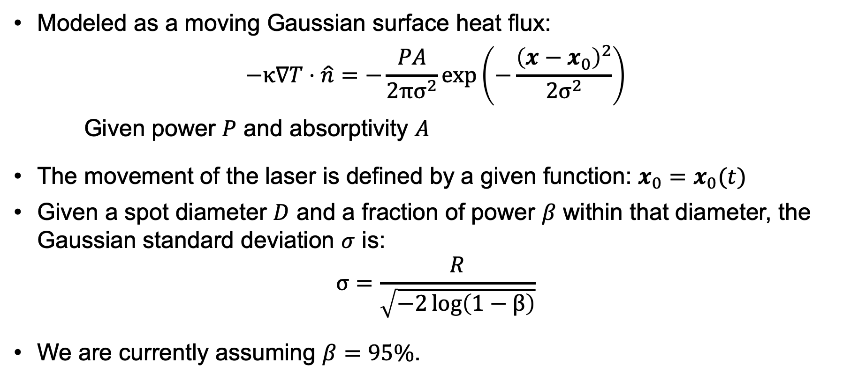
Surface Laser Heating
Modeled as a moving Gaussian surface heat flux:
$$−κ∇T⋅\hat{n}=−\frac{PA}{2πσ^{2}}\exp\left(−\frac{{\left(x−x_{0}\right)}^{2}}{2σ^{2}}\right)$$
Given power $P$ and absorptivity $A$
The movement of the laser is defined by a given function: $x_{0}=x_{0}(t)$
Given a spot diameter $D$ and a fraction of power $β$ within that diameter, the Gaussian standard deviation $σ$ is:
$$σ=\frac{R}{\sqrt{−2\log\left(1−β\right)}}$$
We are currently assuming $β=95\%$.

Slide 10
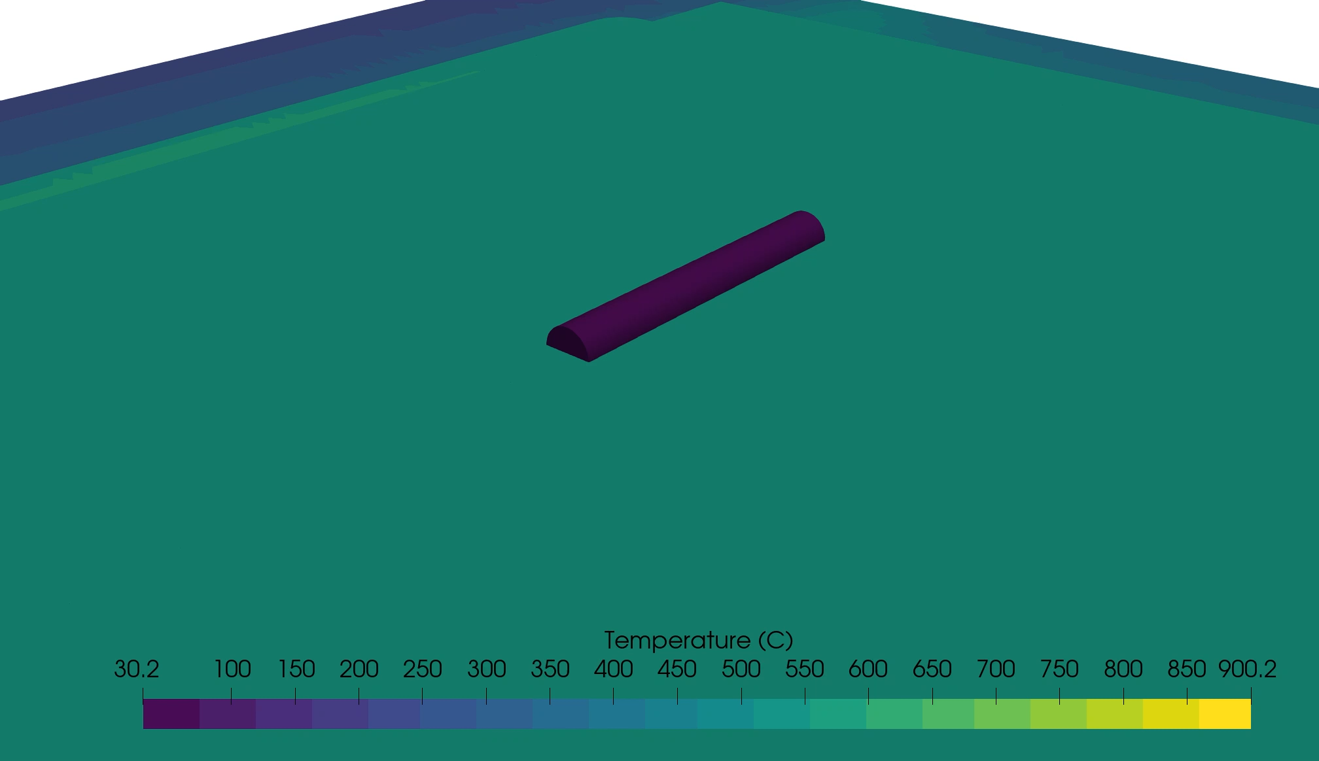
Printing

Slide 11
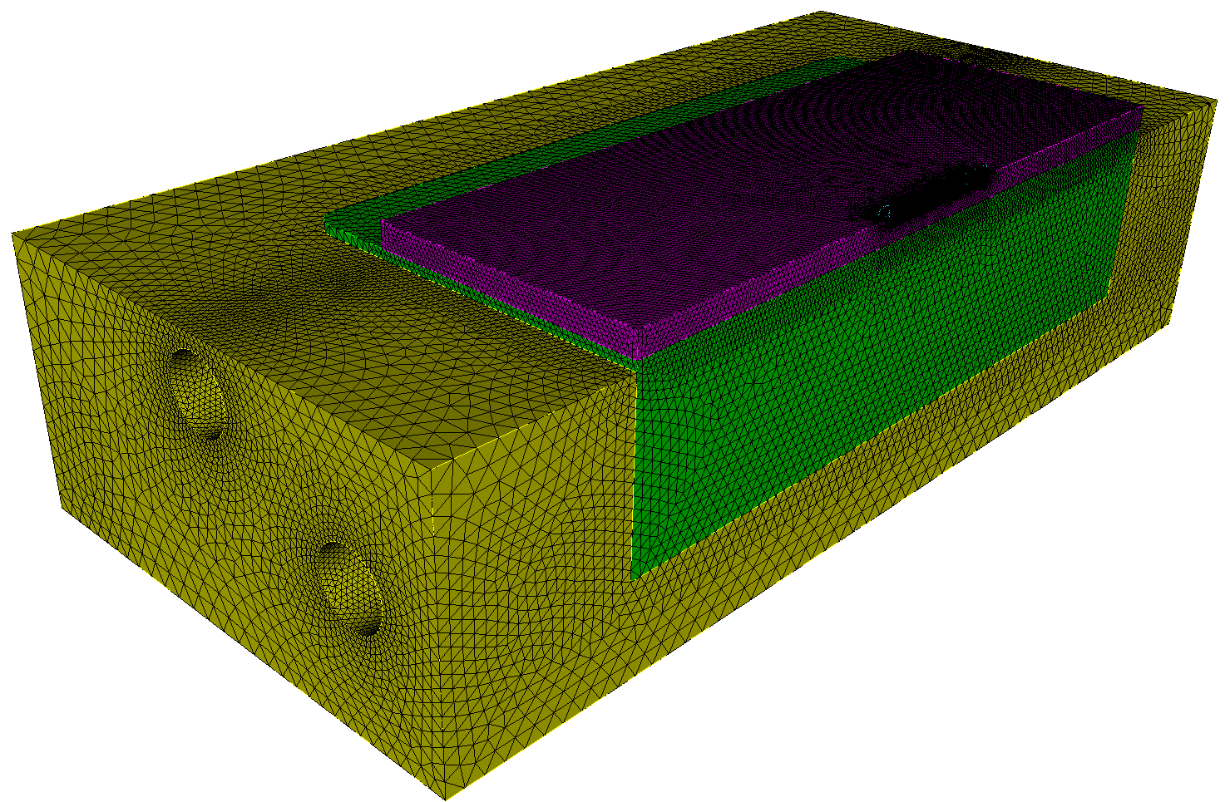
Geometry and Mesh
Lab provided STL geometry for the SS block and macor insulation.
Borosilicate slide is 101.6 mm x 76.2 mm x 3.25 mm
Real borosilicate filament is 2mm diameter.
Model half-cylinder filament of diameter 2.83 mm to match cross-sectional area and mass deposition rate.
Half-symmetry

Slide 12
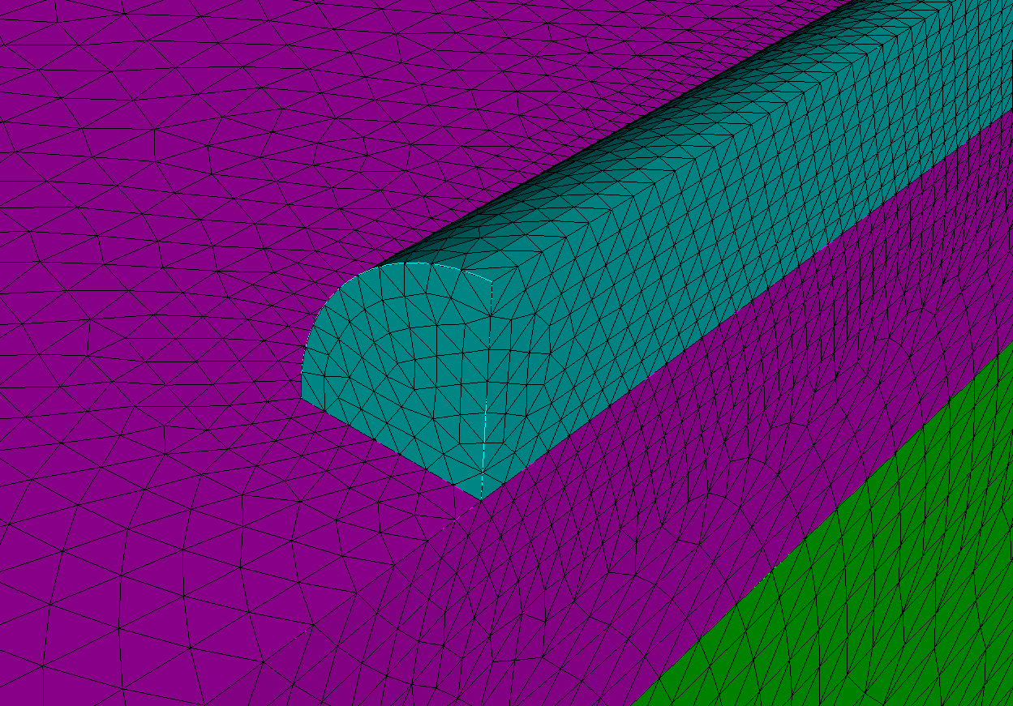
Geometry and Mesh (cont.)
Tetrahedral mesh generated by Cubit
3-mm resolution in the insulation
1.5-mm resolution in the block
0.67-mm resolution in the slide
0.2-mm resolution in the filament
Resolution adapts to geometry

Slide 13
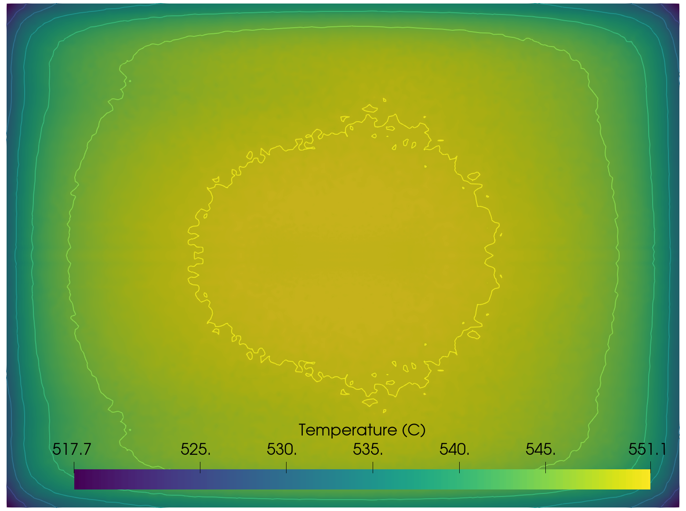
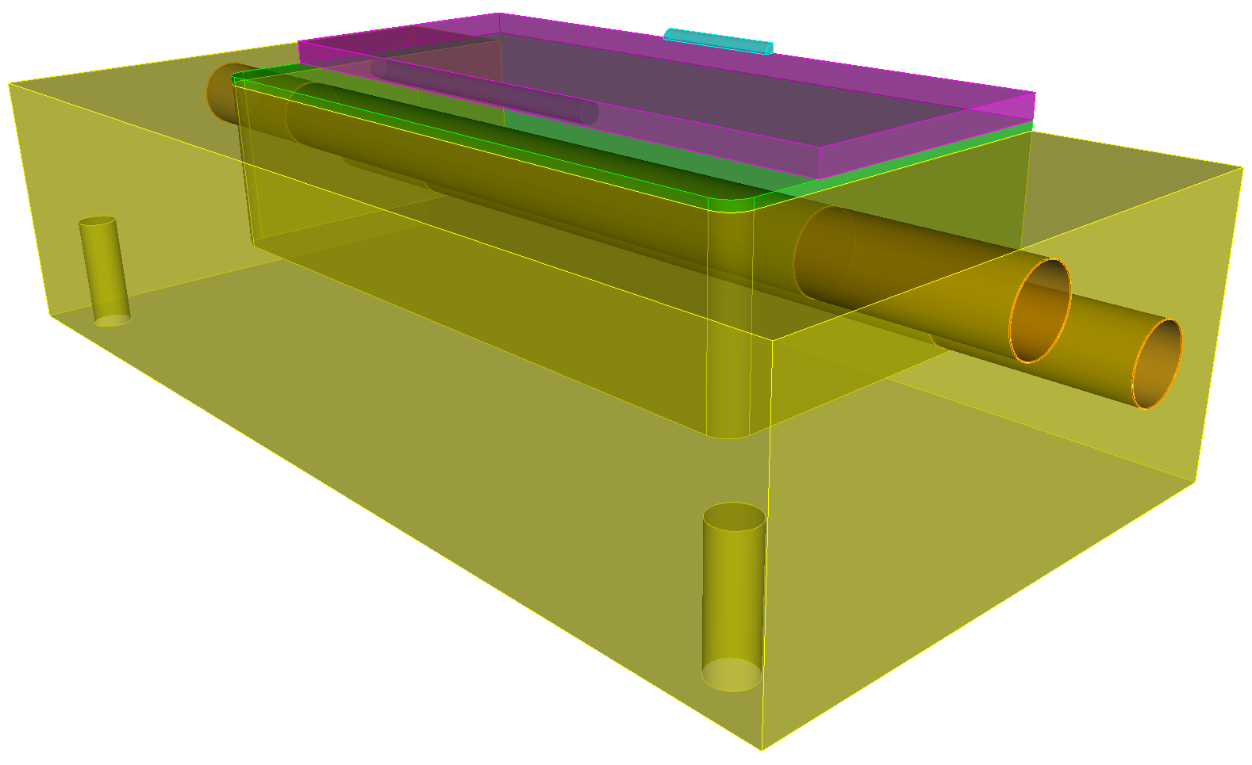
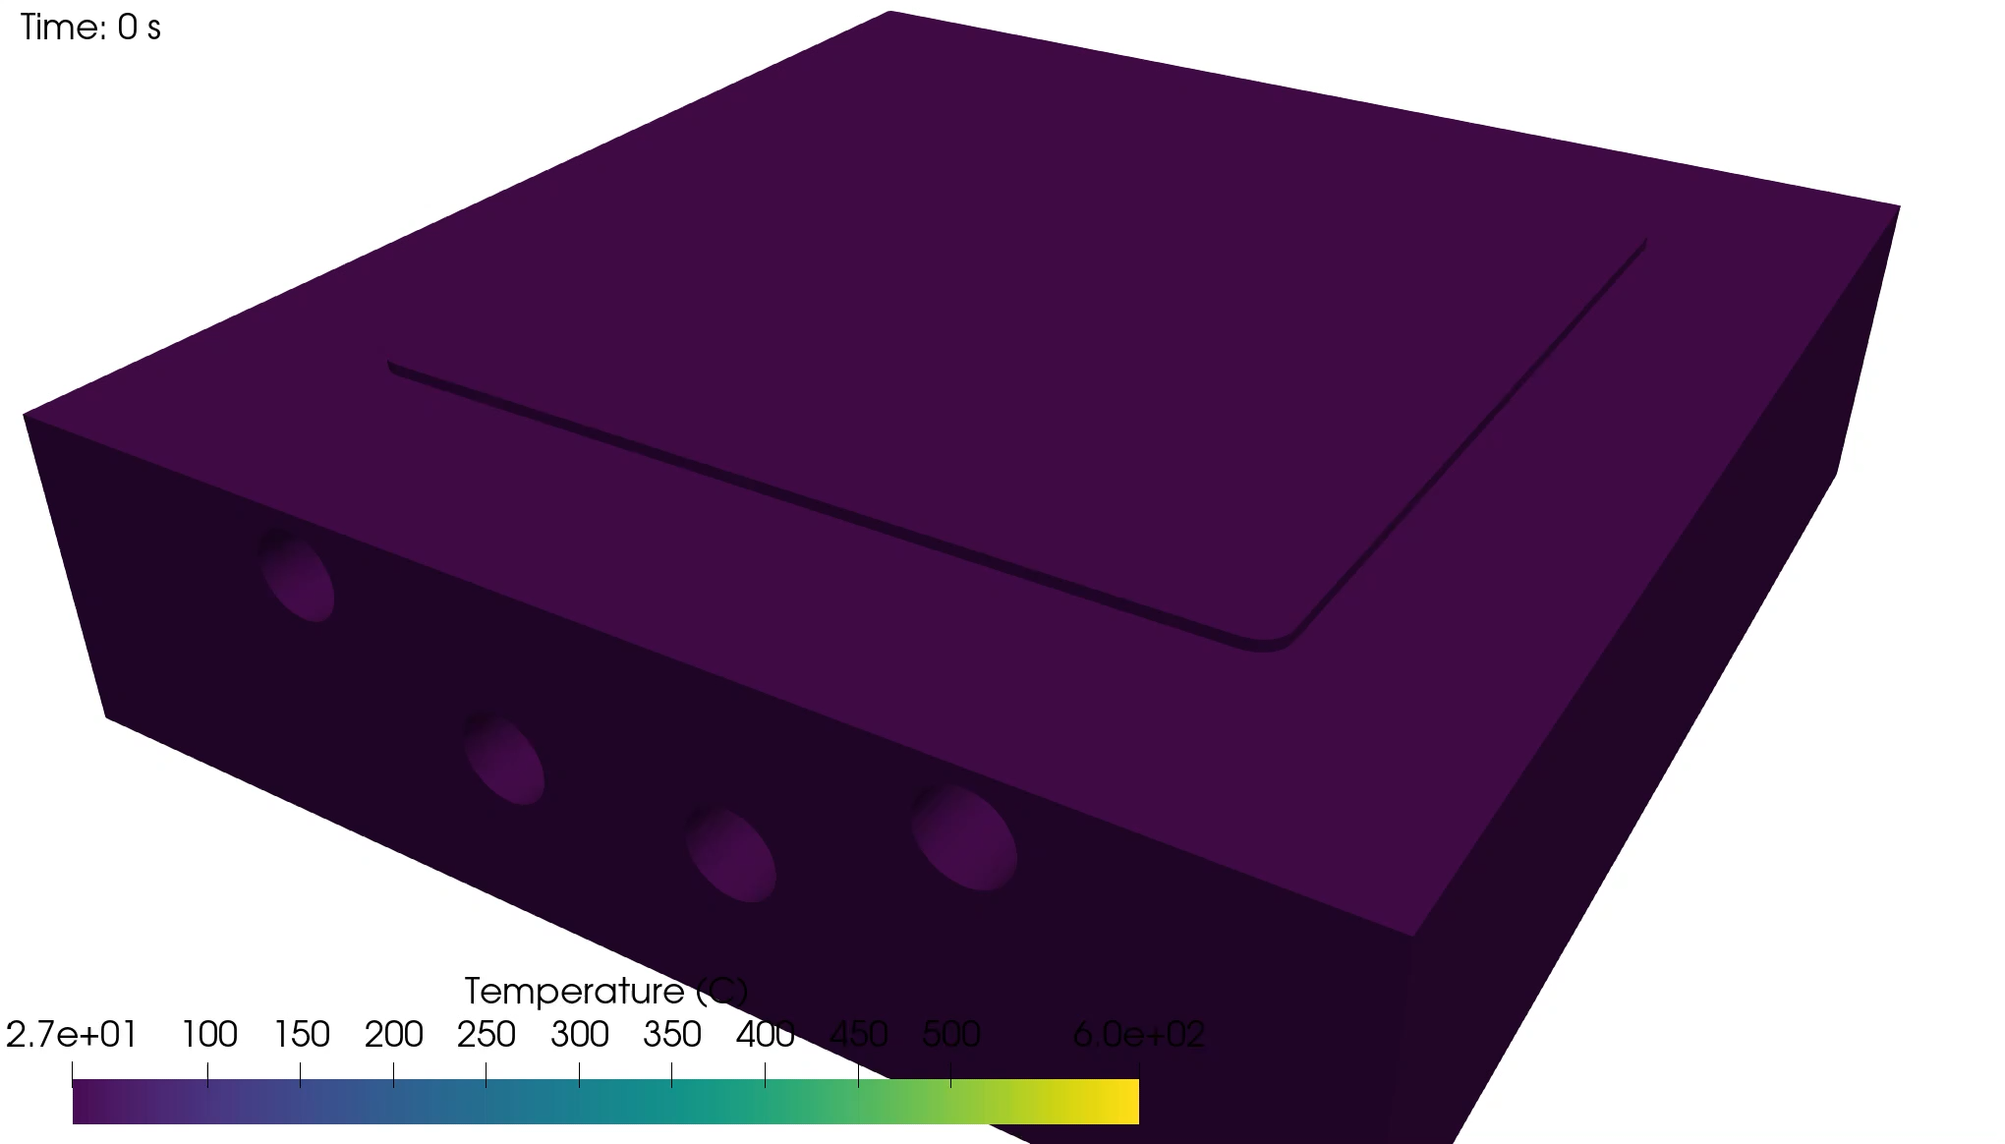
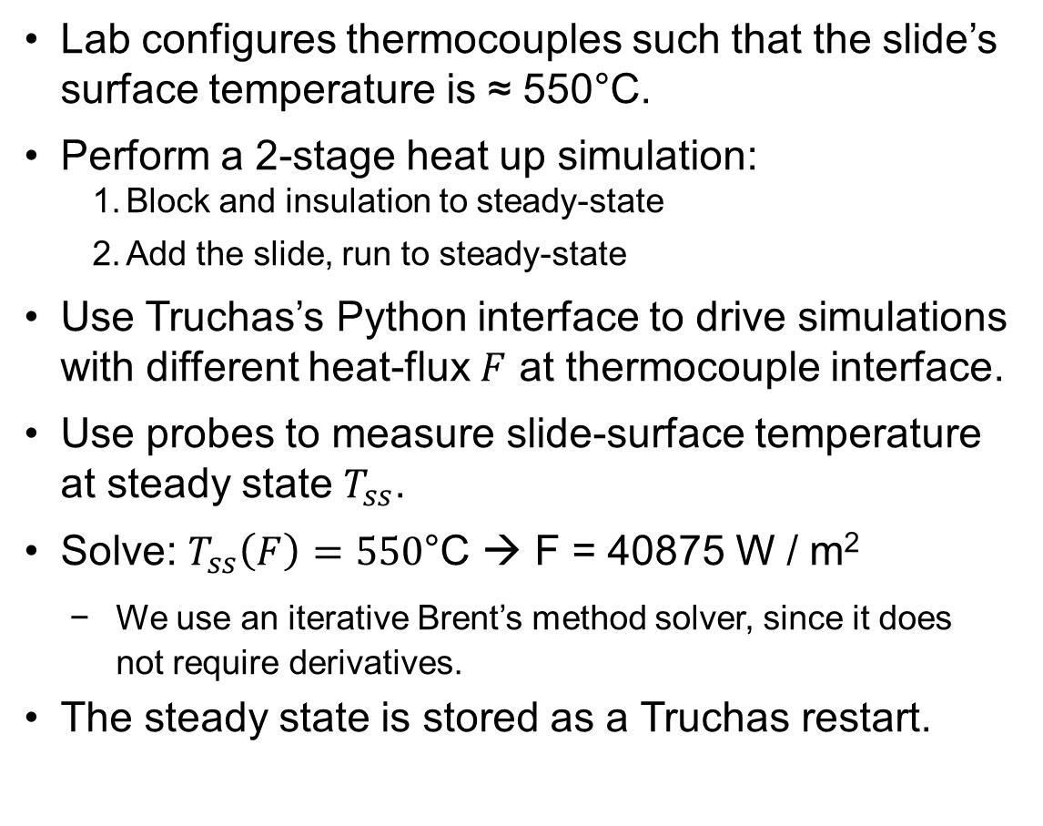
Block and Slide Heat Up
Lab configures thermocouples such that the slide’s surface temperature is ≈ 550°C.
Perform a 2-stage heat up simulation:
Block and insulation to steady-state
Add the slide, run to steady-state
Use Truchas’s Python interface to drive simulations with different heat-flux $F$ at thermocouple interface.
Use probes to measure slide-surface temperature at steady state $T_{ss}$.
Solve: $T_{ss}\left(F\right)=550$°C → F = 40875 W / m²
We use an iterative Brent’s method solver, since it does not require derivatives.
The steady state is stored as a Truchas restart.
Notes:
The total flux corresponds to 765 W of power going to the thermocouples (all 4 combined, after losses)

Slide 14
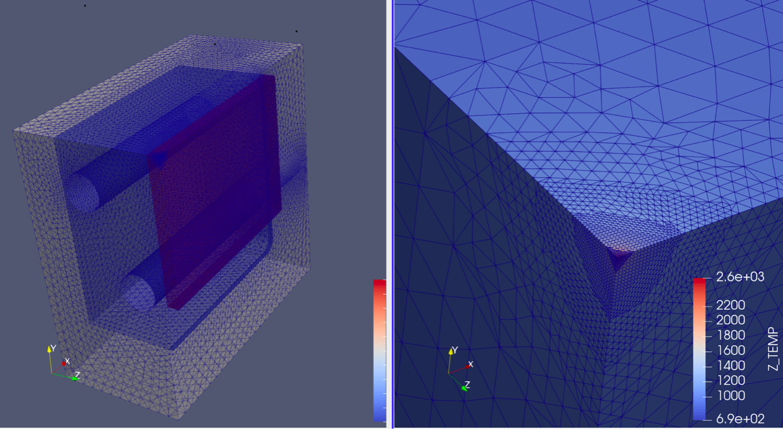
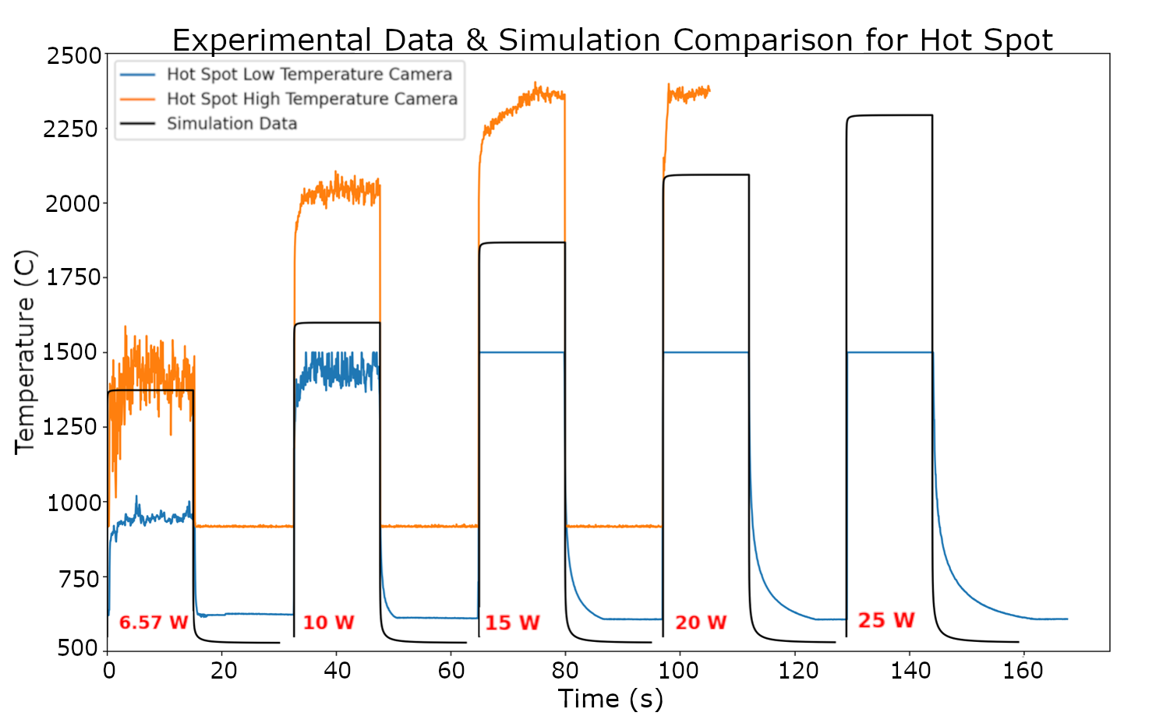
Validation: Spot Melt
Performed a spot melt on borosilicate.
0.3-mm spot size – smallest possible experimentally.
Vary laser power 6.5 W–25 W.
Compare the simulated and experimental maximum temperatures at steady state.
At low temperature, we match the high- temperature camera.
At higher temperatures, simulation predicts lower temperatures.
This is highly sensitive to thermal conductivity at high temperatures, a poorly studied regime!

Slide 15
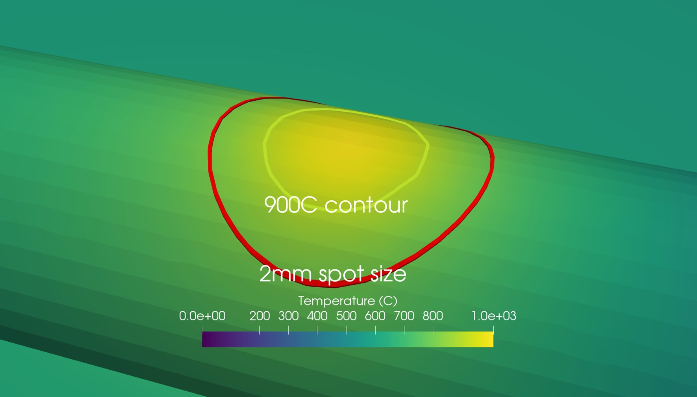
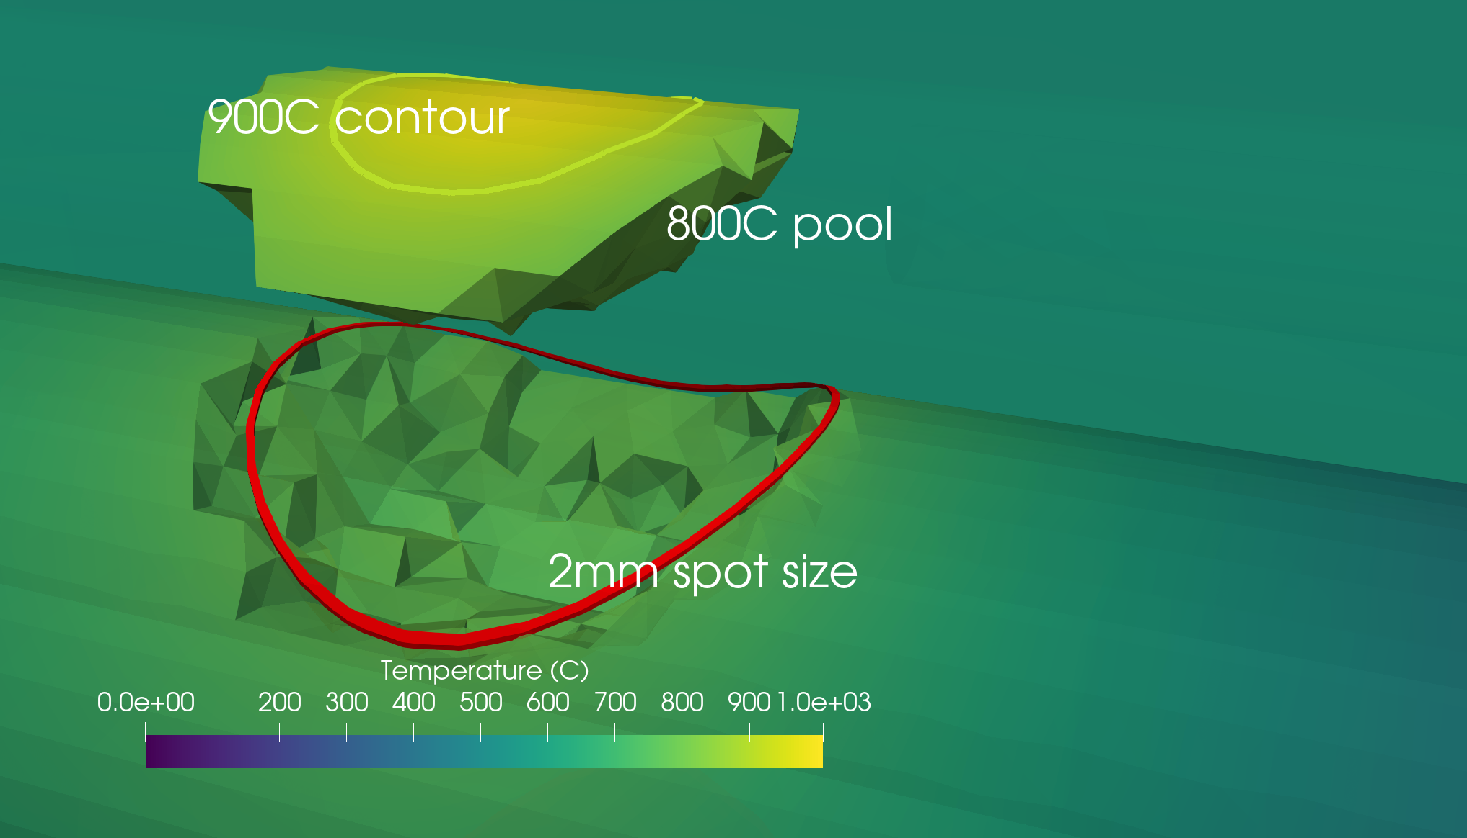
Results: Temperature Field
For 15-W laser, 2-mm spot size,
1-mm/s scan speed, 2-mm borosilicate rod
Max temperature is 1100°C
900°C contour has 0.6-mm radius (at surface)
800°C contour has 1-mm radius (at surface)
800°C contour has 0.78-mm maximum depth

Slide 16
Results: Melt-Pool Heat Transfer Modes
Total flux for each mode of heat transfer is measured in and out of the melt pool (MP) (800°C contour) at steady state.
Convection is negligible at the melt pool, accounting for <0.6% of MP heat loss.
Radiation is insignificant, accounting for < 3% of MP heat loss.
6% of light is reflected before it can be absorbed by the glass.
Conduction within the glass is by far the primary mode of heat transfer, accounting for > 95% of MP heat loss.
Modeling importance: conductivity > absorptivity > radiation > convection
Laser Power (W) | 15 | 20 | 20
Laser Size (mm) | 2 | 2 | 2
Laser Concentration β | 95% | 95% | 99%
Max. Temp (C) | 1009 | 1109 | 1111
MP width (mm) | 1.9602 | 2.446 | 1.713
MP depth (mm) | 0.7756 | 1.192 | 0.6721
MP volume (mm^3) | 0.6627 | 1.8802 | 0.4342
Reflected laser (W) | 0.85 | 1.19 | 1.16
Absorbed laser (W) | 13.31 | 18.7 | 18.17
Radiative loss (W) | -0.28 | -0.5792 | -0.2457
Convective loss (W) | -0.0562 | -0.1103 | -0.04359
Conductive loss (W) | -12.97 | -18 | -17.88

Slide 17
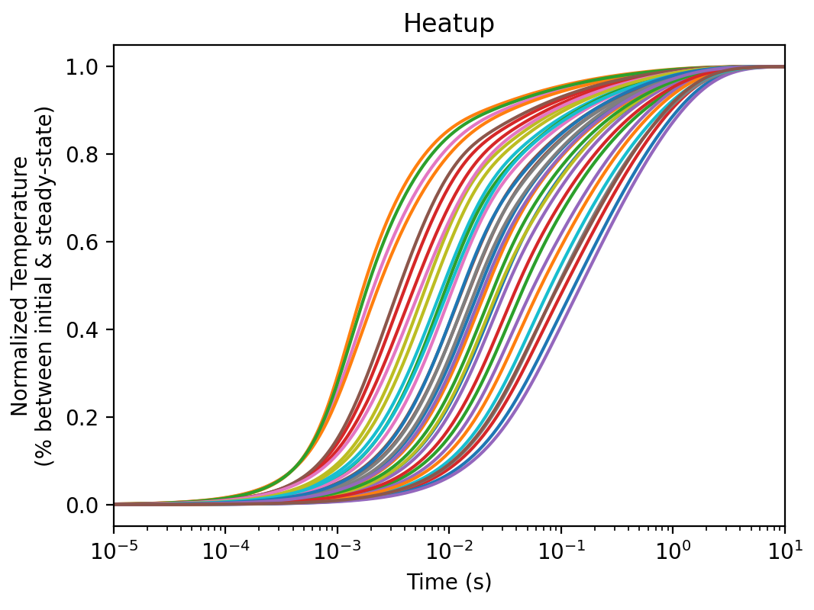
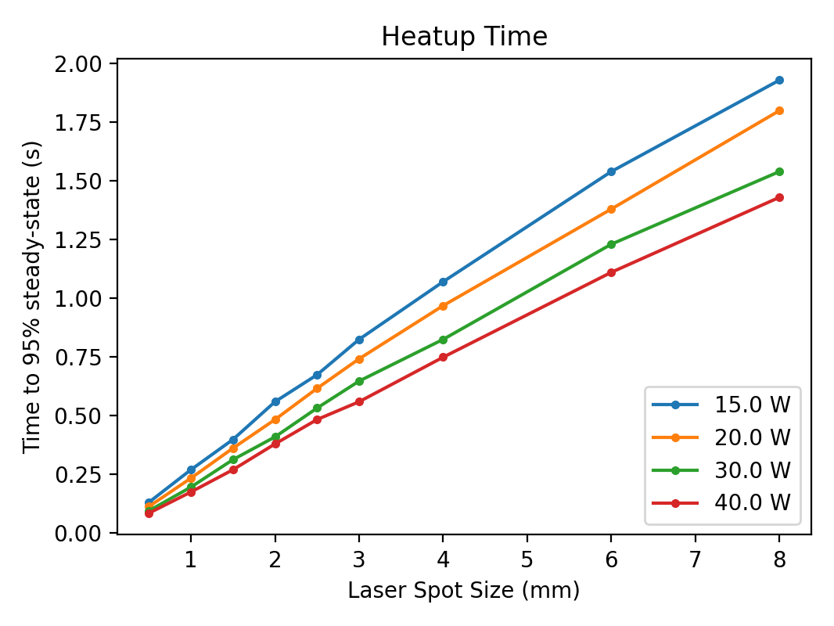
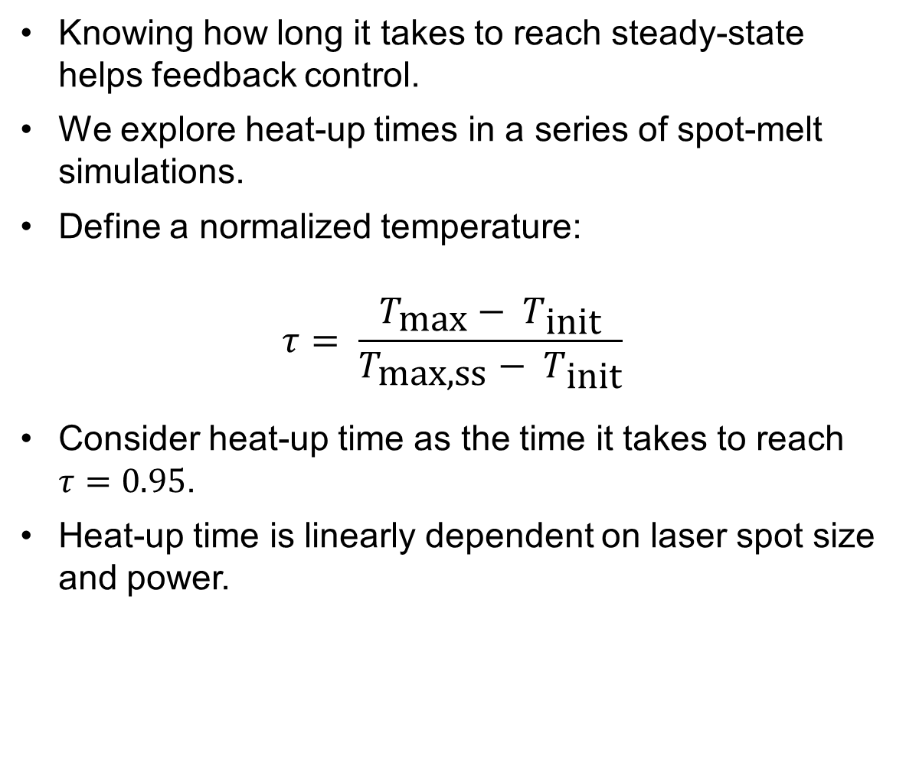
Results: Heat-Up Times
Knowing how long it takes to reach steady-state helps feedback control.
We explore heat-up times in a series of spot-melt simulations.
Define a normalized temperature:
$$τ= \frac{T_{\text{max}}− T_{\text{init}}}{T_{\text{max}\text{,}\text{ss}}− T_{\text{init}}}$$
Consider heat-up time as the time it takes to reach $τ=0.95$.
Heat-up time is linearly dependent on laser spot size and power.

Slide 18
Summary
We can model the thermal aspects of glass additive manufacturing with a static mesh and dynamic interface conditions.
Accuracy is very sensitive to thermal conductivity, which is poorly studied at high temperatures and varies significantly across glass compositions.
This is an evolving research project; more work into material properties is required
Next steps:
More research into high-temperature material properties.
Glass slumping model using multimaterial, incompressible, viscous flow.
Residual stress calculations based on small-strain viscoplastic flow.

Slide 19
Backup Slides

Slide 20
Glass Laser Additive Manufacturing System (GLAMS)
Simulate block heat up to steady-state.
Add slide; simulate heat up to steady-state.
A Truchas restart (physics state checkpoint) is generated from this stage. Many print simulations can run from this restart.
Add filament body; slide into thermal contact and apply laser heat flux.
Parameter studies are done on this simulation stage.

Slide 21
Glass Laser Additive Manufacturing System (GLAMS) (cont.)
Output metrics include the following.
Complete temperature field and temperature gradients over time
Maximum temperature
Size of a melt-pool defined by a temperature iso-surface (length, width, height, volume)
Heat fluxes in and out of melt-pool (absorbed laser, radiation, conductivity, convection)
Heuristic vaporization estimate, calibrated against lab data (post-processing)
Max, min, and average temperatures in arbitrary mix-cup geometry

Slide 22
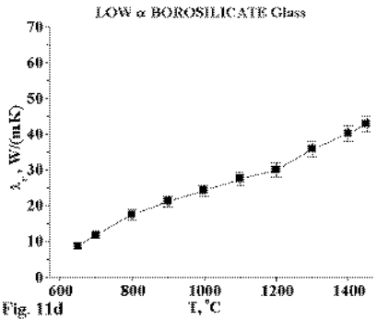
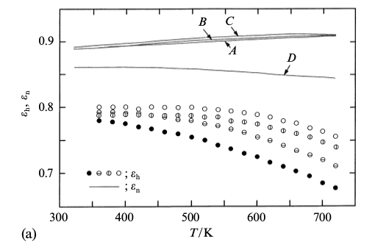
Borosilicate Material Properties
Property | Value
Density | 2200 kg / m^3
Specific heat | 850 J / kg K
Emissivity | 0.8
Absorptivity | 0.94
Borosilicate conductivity (Seward, 2003)
Borosilicate emissivity (Sasaki et al., 2003)

Slide 23
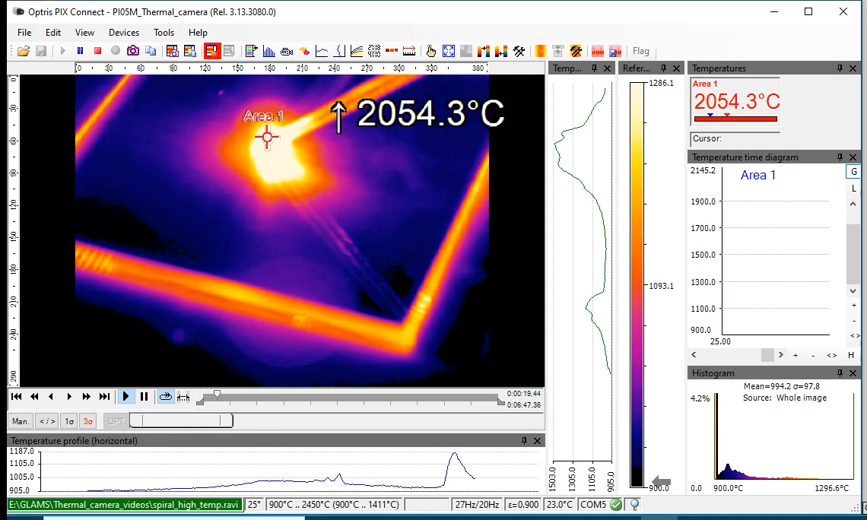
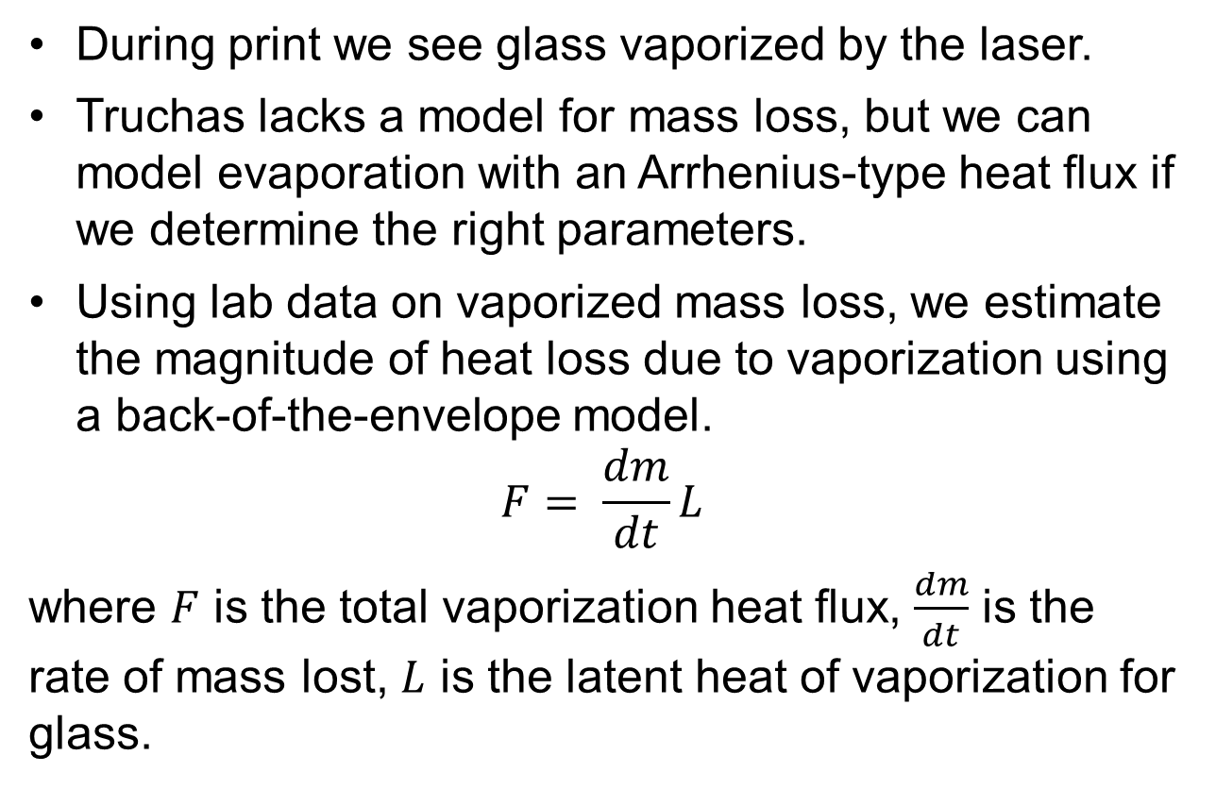
Empirical Vaporization Model
During print we see glass vaporized by the laser.
Truchas lacks a model for mass loss, but we can model evaporation with an Arrhenius-type heat flux if we determine the right parameters.
Using lab data on vaporized mass loss, we estimate the magnitude of heat loss due to vaporization using a back-of-the-envelope model.
$$F= \frac{dm}{dt}L$$
where $F$ is the total vaporization heat flux, $\frac{dm}{dt}$ is the rate of mass lost, $L$ is the latent heat of vaporization for glass.

Slide 24
Empirical Vaporization Model
Lab measured mass loss for 80 s prints with 2-mm spot size at various laser powers, finding 0.01–0.2 mg/s vaporization mass rate.
Latent heat of vaporization for glass is not well studied. We’ll assume a value inside the range for most other materials: 750e3 J / kg.
At 20 W and MP at 800°C cutoff:
Vaporizing 30% of the melt pool over 60s.
1.6e-2 W vaporization heat flux; 0.08% of MP heat loss.
An order of magnitude less significant than convection.

Slide 25
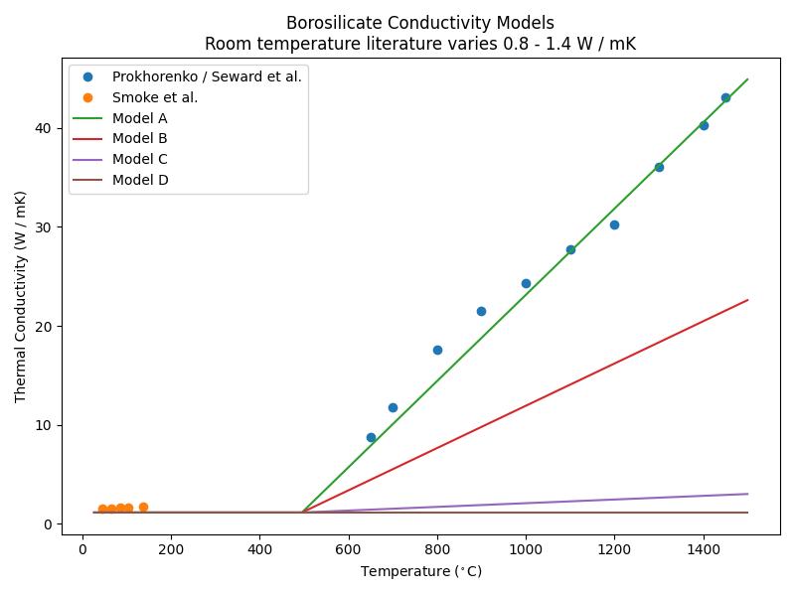
A: Literature fit
33 W / mK at 1500 K
B: Error minimization for spot collection 1
16.8 W / mK at 1500 K
C: Visual error minimization for spot collection 2
2.5 W / mK at 1500 K
D: Flat
1.14 W / mK

Slide 26
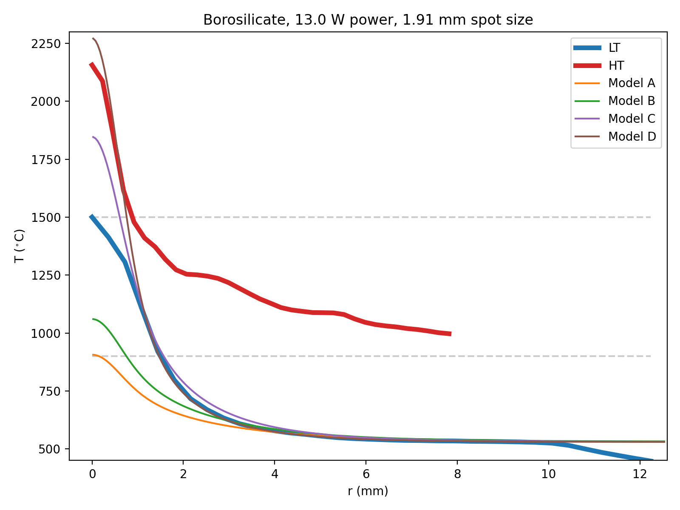

Slide 27
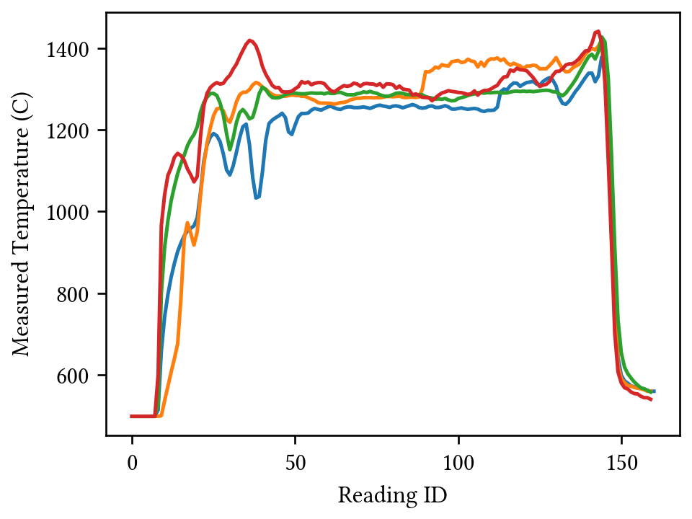
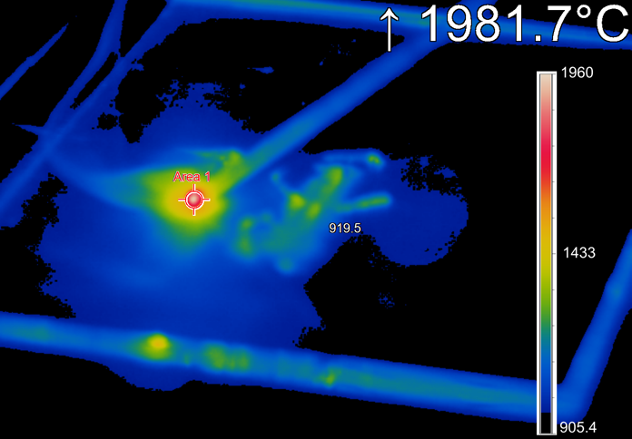
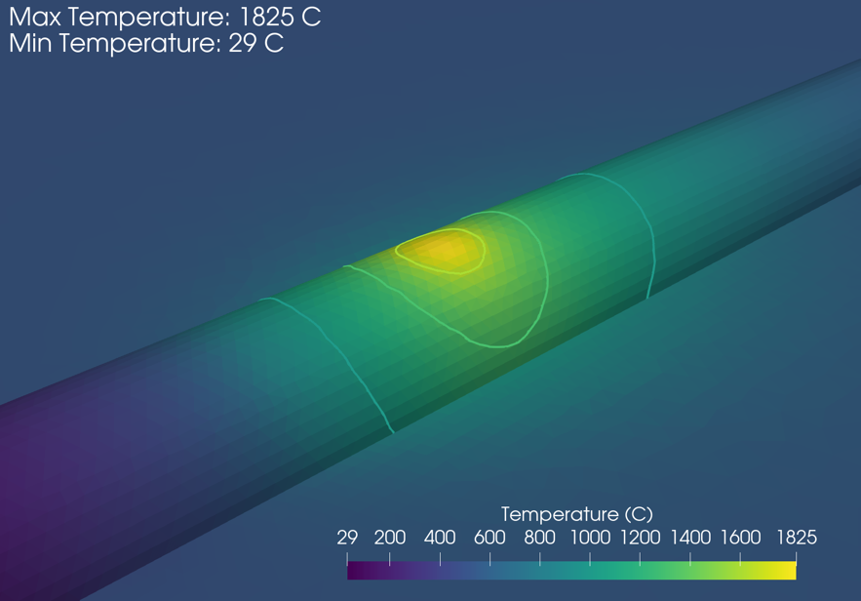
Results: Soda Lime Print Validation
Printed soda lime, 13.2-W laser, 1-mm/s scan speed, 30-mm length, slide heated to 500°C.
Thermal camera recorded max steady-state temperature of 1981.7°C.
Pyrometer recorded temperature of 1280°C ± 25°C.
Simulation recorded maximum temperature of 1825°C and qualitatively similar temperatures in the immediate vicinity of the laser.
Temperatures recorded far outside the regime where conductivity is measured

Slide 28
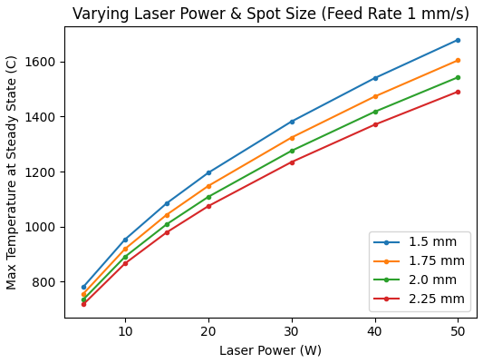
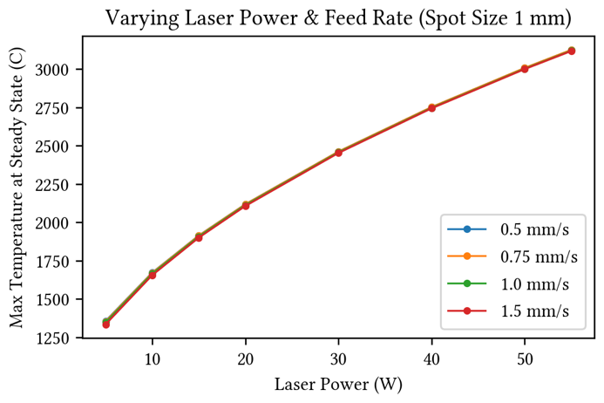
Parameter Studies
Python driver used to run Truchas with varying inputs, read outputs, and collect quantities of interest.
Simulations can be farmed out to a cluster to run simultaneously
Power and size with borosilicate.
Power and speed with soda lime.

